Slide 1
Module 1
Introduction to computer graphics

Slide 2


Input / Output Devices
1.1 Input Device
1.2 Output Device

Slide 3
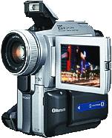

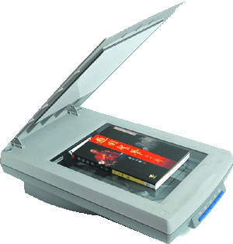

1.1Input Devices
Motivation
Match the following tasks with the suitable input device.
Recording
Photo
Presentation
Speaking
Photo-editing
Sights
Video-taking
Text

Slide 4
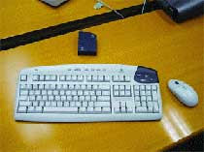

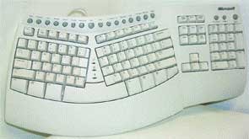
1.1Input Devices
Keyboard
Keyboard is made up of character, numerical and functional keys, it is the most common input device
Multimedia Keyboard
Wireless Keyboard
Virtual Keyboard
Ergonomic Keyboard

Slide 5
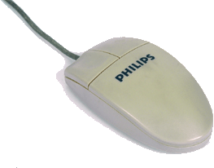

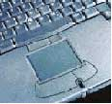
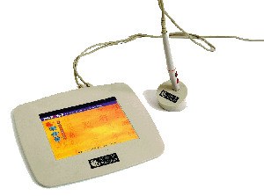
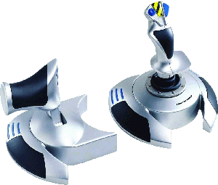

1.1Input Devices
Pointing Devices
Mouse, Trackball, Touchpad and Digitising Table are common pointing devices that will help users operate a computer more easily

Slide 6

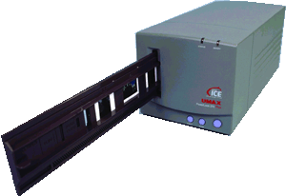
1.1Input Devices
Scanner
Scanner is a device used to convert a still image into a digital one. It can read text or illustrations printed on paper and translate the information into a form the computer can use
Film scanner
Bar code reader
Flatbed scanner

Slide 7
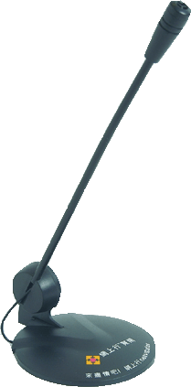
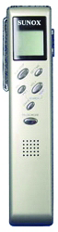
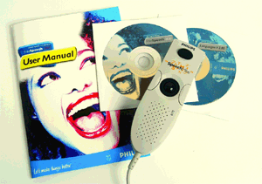
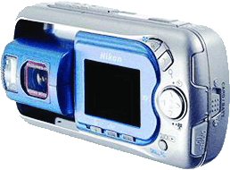
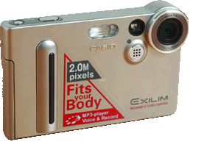
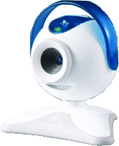
1.1Input Devices
Sound Input Tool
Digital Camera
Digital Video Camera
Digital recorder
A Speech Recognition System
Microphone
Web Camera
Digital Video Camera

Slide 8
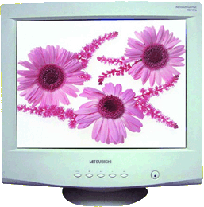
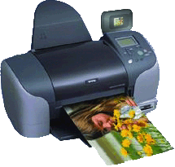
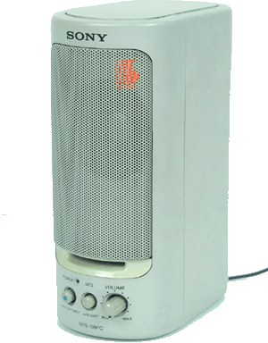
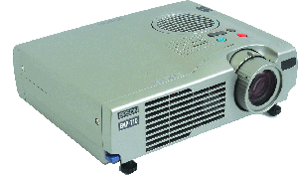
1.2 Output Device
Motivation
Match the following tasks with the suitable output device:
Printing a
photo
Speaking
Presenting
a report
Photo
Presentation
slide
Playing a
video
Playing a
speech
Visual video

Slide 9
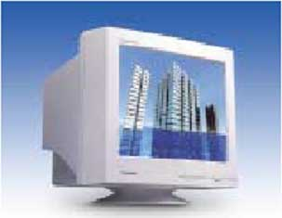
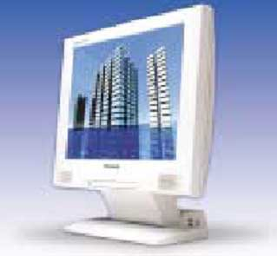
1.2 Output Device
Monitor
‧There are two main types of monitor, namely the CRT (Cathode Ray Tube) monitor and the LCD (Liquid Crystal Display) monitor.
‧They can show the data processed by the computer in the form of text, images or visual information.
‧The output on the monitor is only temporary and can only be viewed on the computer screen.

Slide 10
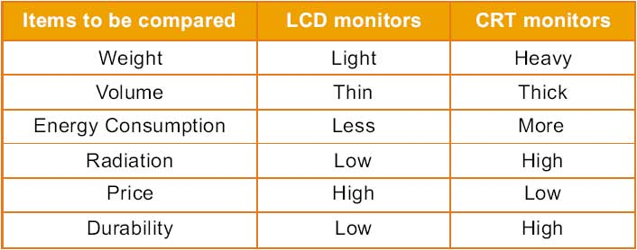
1.2 Output Device
LCD monitors and CRT monitors are compared in the following table:

Slide 11
LED monitor
Short for light-emitting diode monitor, an LED monitor or LED display is a flat screen, flat panel computer monitor or television. It has a very short depth and is light in terms of weight. The actual difference between this and a typical LCDmonitor is the backlighting. The first LCD monitors used CCFLinstead of LEDs to illuminate the screen.
LED monitor advantages
LED monitors offer many benefits when compared to those that are CCFL lit including:
Often less expensive.
Overall more reliable.
They run at a lower temperature, and consume much less power, as few as 20 watts.
Higher dynamic contrast ratio.
Longer lifespan and less environmental impact.

Slide 12
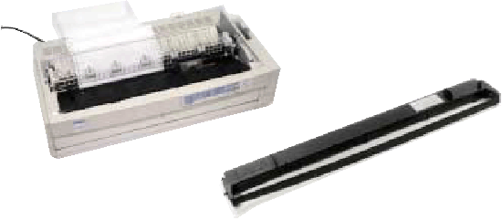
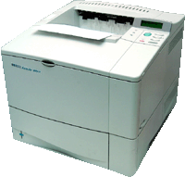
1.2 Output Device
Printer
‧A printer can place text or graphics onto a paper or a slide, which is known as a hard copy.
‧Three type of printer：Dot-matrix Printer, InkJet Printer and Laser Printer
Laser Printer
Dot-matrix Printer
InkJet Printer

Slide 13
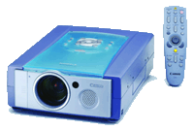
1.2 Output Device
Projector
Speaker

Slide 14
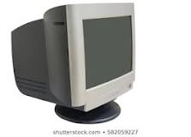
CRT

Slide 15
Scan conversion definition
It is a process of representing graphics objects a collection of pixels.
The graphics objects are continuous.
The pixels used are discrete.
Each pixel can have either on or off state.
The circuitry of the video display device of the computer is capable of converting binary values (0, 1) into a pixel on and pixel off information.
0 is represented by pixel off. 1 is represented using pixel on.
Any model of graphics can be reproduced with a dense matrix of dots or points.

Slide 16
Examples of objects which can be scan converted
Point
Line
Sector
Arc
Ellipse
Rectangle
Polygon
Characters
Filled Regions

Slide 17
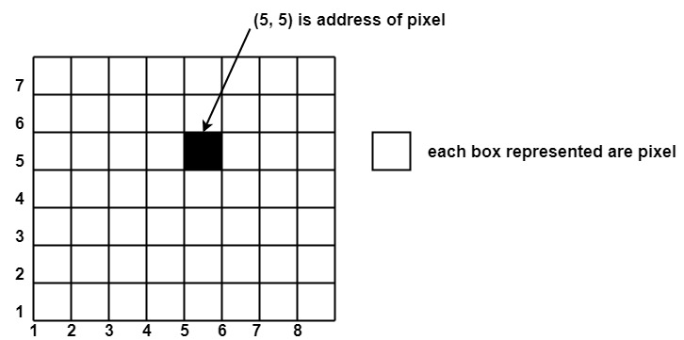
Pixel or Pel
The term pixel is a short form of the picture element.
It is also called a point or dot.
It is the smallest picture unit accepted by display devices.
A picture is constructed from hundreds of such pixels.
Pixels are generated using commands.
Lines, circle, arcs, characters; curves are drawn with closely spaced pixels. To display the digit or letter matrix of pixels is used.
The closer the dots or pixels are, the better will be the quality of picture. Closer the dots are, crisper will be the picture. Picture will not appear jagged and unclear if pixels are closely spaced. So the quality of the picture is directly proportional to the density of pixels on the screen.
Pixels are also defined as the smallest addressable unit or element of the screen. Each pixel can be assigned an address as shown in fig:

Slide 18
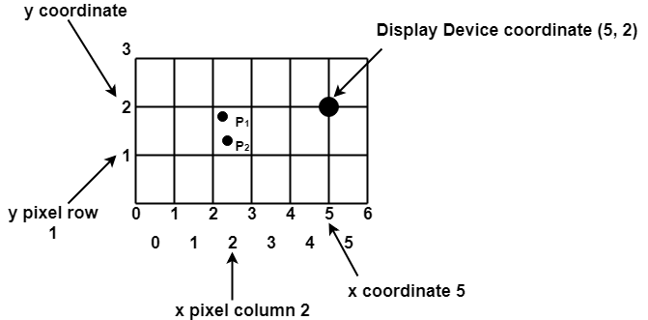
Scan Converting a Point
Each pixel on the graphics display does not represent a mathematical point. Instead, it means a region which theoretically can contain an infinite number of points. Scan-Converting a point involves illuminating the pixel that contains the point.
Example: Display coordinates points Scan Converting a Point as shown in fig would both be represented by pixel (2, 1). In general, a point p (x, y) is represented by the integer part of x & the integer part of y that is pixels [(INT (x), INT (y).

Slide 19
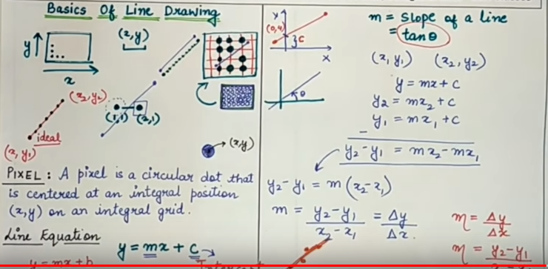

Slide 20
The process of converting is also called as rasterization. The algorithms implementation varies from one computer system to another computer system. Some algorithms are implemented using the software. Some are performed using hardware or firmware. Some are performed using various combinations of hardware, firmware, and software.

Slide 21
Raster Scan Display

Slide 24
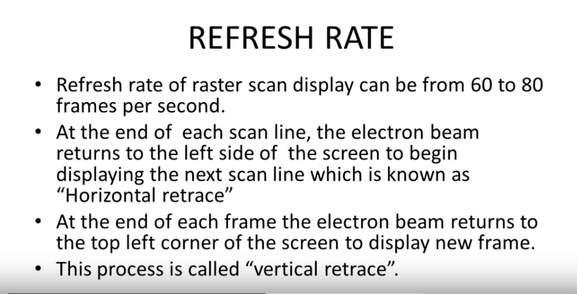

Slide 27
Random Scan Display(Vector Scan Display)

Slide 29
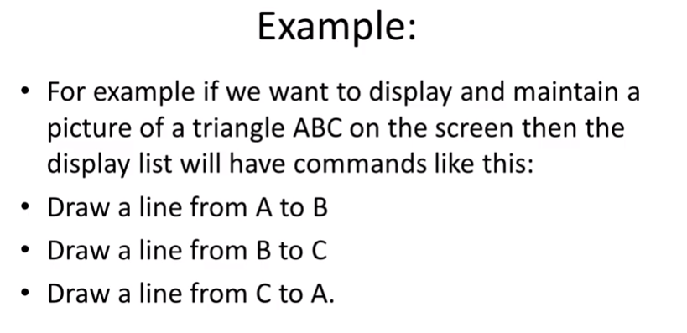

Slide 30
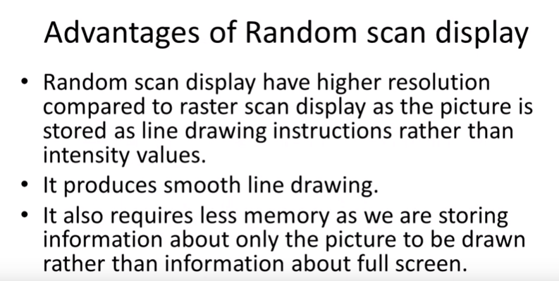

Slide 31
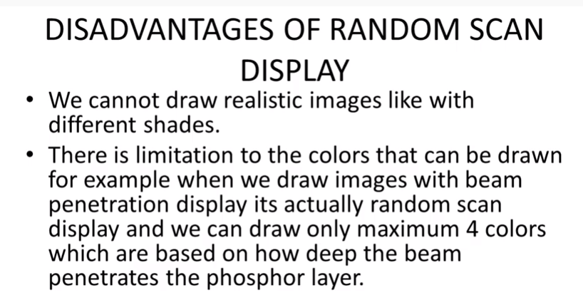

Slide 32
Line Drawing Algorithms
A line in Computer graphics is a portion of straight line that extends indefinitely in opposite direction.
It is defined by its two end points.
Its density should be independent of line length.
the slope intercept equation for a line:
y = mx + b (1)
where, m = Slope of the line
b = the y intercept of a line

Slide 33
The two endpoints of a line segment are specified at positions (x1,y1) and (x2,y2).
y
P2(x2,y2)
P1(x1,y1)
b
0
x

Slide 34
We can determine the value for slope m & b intercept as
m = y2-y1/x2-x1
i.e. m= Δy/ Δx (2)

Slide 35
Example 1 The endpoints of line are(0,0) & (6,18). Compute each value of y as x steps from 0 to 6 and plot the result.
Solution : Equation of line is y= mx +b
m = y2-y1/x2-x1= 18-0/6-0 = 3
Next the y intercept b is found by plugging y1& x1 into the equation y = 3x + b,
0 = 3(0) + b. Therefore, b=0, so the equation for the line is y= 3x.

Slide 36
The challenge is to find a way to calculate the next x,y position by previous one as quickly as possible.

Slide 37
DDA Algorithm
The Digital differential analyzer (DDA) algorithm is an incremental scan-conversion method.
Such an approach is characterized by performing calculations at each step using results from the preceding step.

Slide 38
Algorithm:
(x1,y1) (x2,y2) are the end points and dx, dy are the float variables.
Where dx= abs(x2-x1) and dy= abs(y2-y1)
(i) If dx >=dy then
length = dx
else
length = dy
endif

Slide 39
(ii) dx = (x2-x1)/length
dy = (y2-y1)/length
(iii) x = x1 + 0.5
y = y1 + 0.5
(iv) i = 0
(v) Plot ((x), (y))
(vi) x = x + dx
y = y + dy
(vii) i = i + 1

Slide 40
(viii) If i < length then go to step (v)
(ix) Stop
Example 2 Scan convert a line having end points (3,2) & (4,7) using DDA.
Solution: dx= x2 - x1 = 4-3 = 1
dy= y2 - y1 = 7-2 = 5
As, dx < dy then
length = y2-y1 = 5
dx = (x2-x1)/ length = 1/5 =0.2
dy = (y2-y1)/ length = 5/5 = 1

Slide 41
x1 | y1 | x2 | y2 | L | dx | dy | i | x | y | Result | Plot
3 | 2 | 4 | 7 | 5 | .2 | 1 | 0 | 3.5 | 2.5 | 3.5, 2.5 | 3,2
 |  |  |  |  |  |  | 1 | 3.7 | 3.5 | 3.7,3.5 | 3,3
 |  |  |  |  |  |  | 2 | 3.9 | 4.5 | 3.9,4.5 | 3,4
 |  |  |  |  |  |  | 3 | 4.1 | 5.5 | 4.1,5.5 | 4,5
 |  |  |  |  |  |  | 4 | 4.3 | 6.5 | 4.3,6.5 | 4,6
 |  |  |  |  |  |  | 5 | 4.5 | 7.5 | 4.5,7.5 | 4,7

Slide 42
Limitations of DDA:
The rounding operation & floating point arithmetic are time consuming procedures.
Round-off error can cause the calculated pixel position to drift away from the true line path for long line segment.

Slide 43
The Bresenham Line Algorithm
The Bresenham algorithm is another incremental scan conversion algorithm
The big advantage of this algorithm is that it uses only integer calculations

Slide 44
The Big Idea
Move across the x axis in unit intervals and at each step choose between two different y coordinates
For example, from position (2, 3) we have to choose between (3, 3) and (3, 4)
We would like the point that is closer to the original line
5
(x_{k}+1, y_{k}+1)
4
(x_{k}, y_{k})
3
(x_{k}+1, y_{k})
2
2
3
4
5

Slide 45
Deriving The Bresenham Line Algorithm
At sample position x_{k}+1 the vertical separations from the mathematical line are labelled d_{upper} and d_{lower}
y_{k+1}
d_{upper}
y
d_{lower}
y_{k}
x_{k}+1
The y coordinate on the mathematical line at x_{k}+1 is:

Slide 46
The Bresenham Line Algorithm
BRESENHAM’S LINE DRAWING ALGORITHM
Input the two line end-points, storing the left end-point in (x₁, y₁)
Calculate the constants Δx i.e. dx, Δy i.e. dy, 2Δy and 2 Δx, get the first value for the decision parameter as:
Initialise starting
Initialise i=1 as a counter,

Slide 47
The Bresenham Line Algorithm (cont…)
Otherwise, the next point to plot is (x_{k}+1, y_{k}+1) and:
Repeat step 4 (Δx – 1) times
The algorithm and derivation above assumes slopes are less than 1. for other slopes we need to adjust the algorithm slightly.

Slide 48
Adjustment
For m>1, we will find whether we will increment x while incrementing y each time.
After solving, the equation for decision parameter p_{k} will be very similar, just the x and y in the equation will get interchanged.

Slide 49
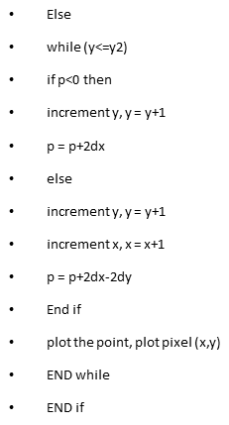
if m<1 then
while (x<= x2
if p<0 then
increment x, x = x+1
p = p+2dy
else
increment x, x = x+1
increment y, y = y+1
p = p+2dy-2dx
end if
plot the point, plot pixel(x,y)
END while

Slide 50
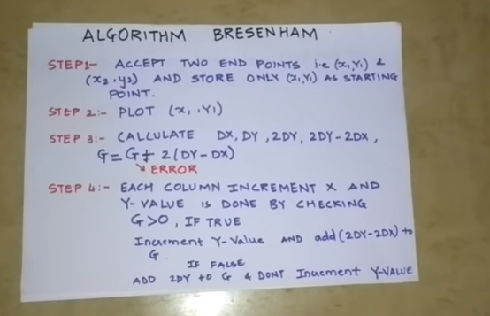

Slide 51
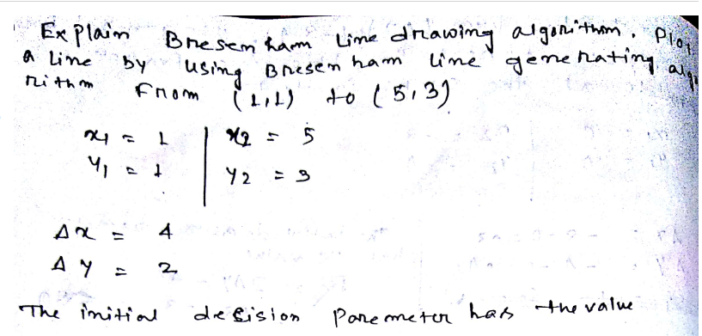

Slide 52
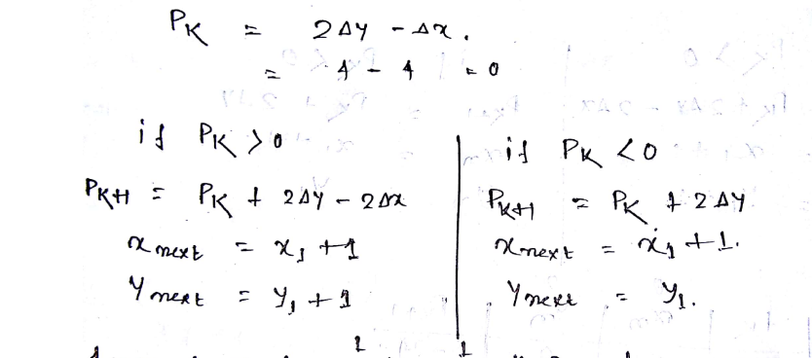

Slide 53
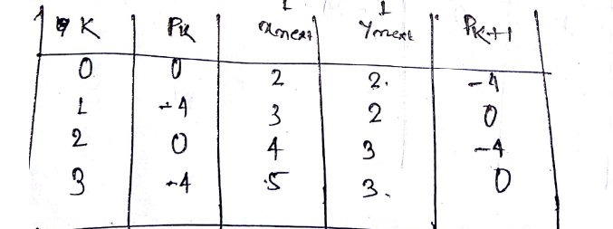

Slide 54
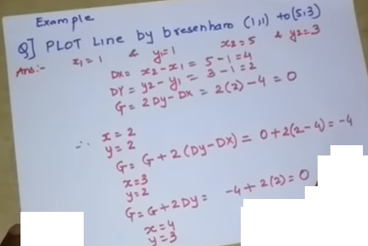

Slide 55
Bresenham Example
Let’s have a go at this
Let’s plot the line from (20, 10) to (30, 18)
First off calculate all of the constants:
Δx: 10
Δy: 8
2Δy: 16
2Δy - 2Δx: -4
Calculate the initial decision parameter p₀:
p0 = 2Δy – Δx = 6

Slide 56
Bresenham Example (cont…)
k | p_{k} | (x_{k+1},y_{k+1})
0 1 2 3 4 5 6 7 8 9
18
17
16
15
14
13
12
11
10
20
21
22
23
24
25
26
27
28
29
30

Slide 57
Bresenham Exercise
Go through the steps of the Bresenham line drawing algorithm for a line going from (21,12) to (29,16)

Slide 58
Bresenham Exercise (cont…)
k | p_{k} | (x_{k+1},y_{k+1})
0 1 2 3 4 5 6 7 8
18
17
16
15
14
13
12
11
10
20
21
22
23
24
25
26
27
28
29
30

Slide 59
Bresenham Line Algorithm Summary
The Bresenham line algorithm has the following advantages:
An fast incremental algorithm
Uses only integer calculations
Comparing this to the DDA algorithm, DDA has the following problems:
Accumulation of round-off errors can make the pixelated line drift away from what was intended
The rounding operations and floating point arithmetic involved are time consuming

Slide 60
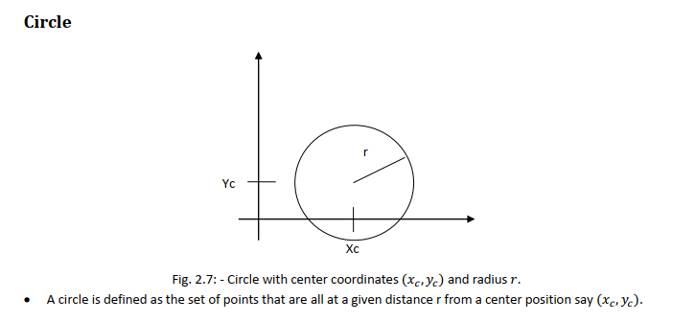

Slide 61
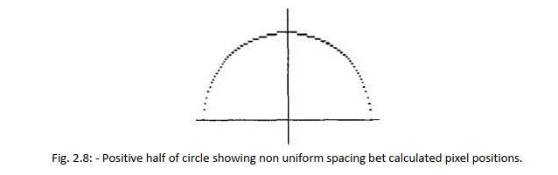

Slide 62
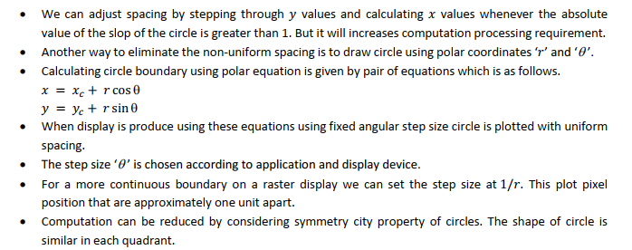

Slide 63
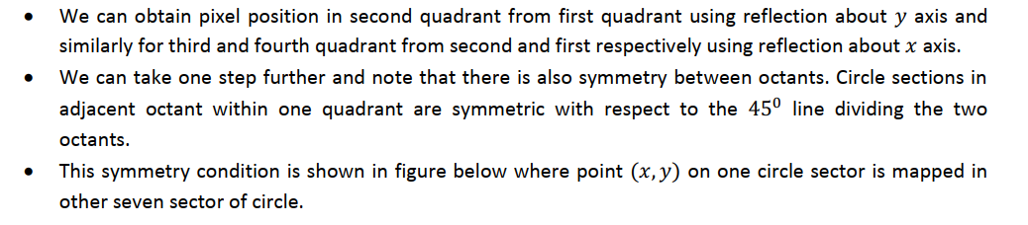
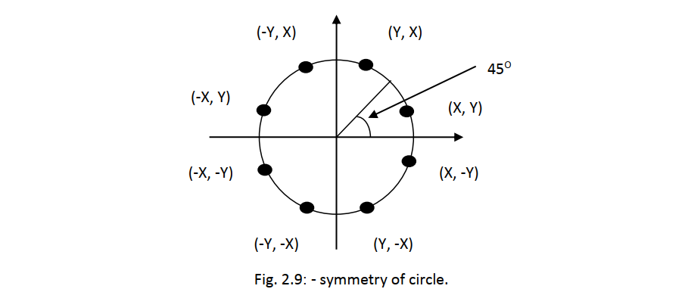

Slide 65
